Slide 1
How does usage of visual aid by showing code compilation during classroom lectures affect a student's understanding?
K1xxx- XYZ
K1xxxxx-Shokat
K1xxxxx9- Azeeb
k1xxxx- ABC

Slide 2
Purpose :
–How audio or visual aids affect a student's understanding.
–Help different colleges decide whether to hold similar assistance with lectures or not.
Limitations: This study is focused on University teachers and students.
May Not be Generalized to Other Levels!!

Slide 3
Significance of the Study
This research will help identify whether students can understand lectures better, hence bringing possible enhancements to the current methods of teaching.

Slide 4
Research Methodology:
–Survey data was collected personally from teachers and students of the computer science department.
Sampling Technique
–The selected population is unbiased.
–Quota sampling was used.
–Selection of people from sub group was random.
–The Second population selected is from the faculty members of FAST .
•Only teachers related to programming have been selected.

Slide 5
Review of Related literature:
“The use of technologies like interactive whiteboards in classrooms can contribute positively to the learning process of a student” ~ William D. Beeland
t-test showed there was no significant difference between the scores amongst groups, but the students preferred and felt positive with the idea of showing videos during lectures
“Concept of pair programming improve the quality of code” Laurie A. Williams and Robert R. Kessler.
Notes:
Point 2 = In August 2013, the effect of showing videos to 10th grade biology students was analyzed by testing two groups of students. One was showed videos in the classroom while the other was not. At the end of the procedure, the students were interviewed for their opinion for videos, and their subject scores were also taken.

Slide 6
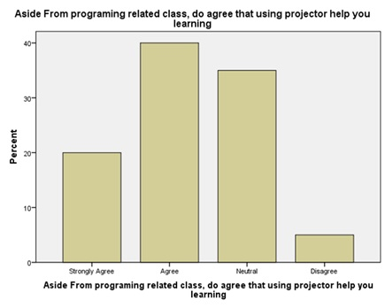
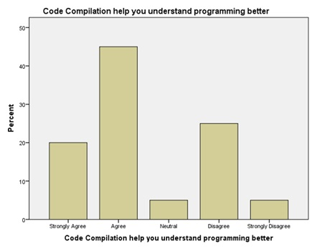
Findings And Discussion

Slide 7
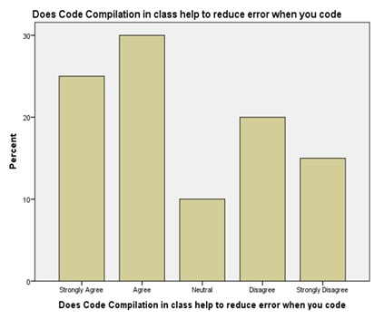
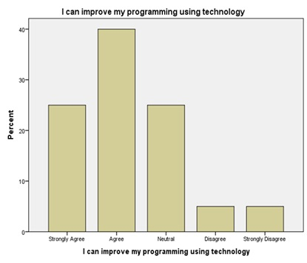

Slide 8
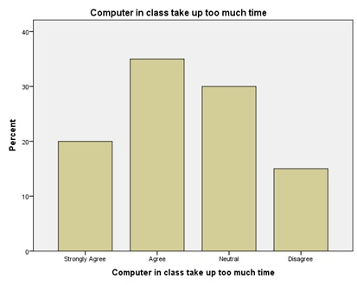
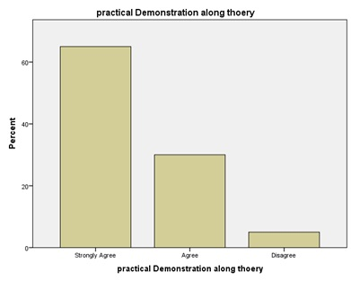
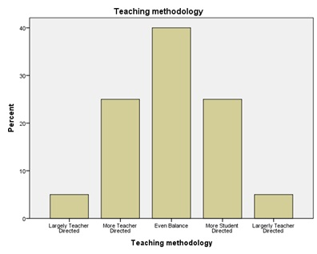

Slide 9
Conclusion
This research was to determine the impact on student’s learning and understanding of programming by showing code compilation in classroom.
student showed positive response towards using such technique in class.
Notes:
Smja do

Slide 10
Recommendation:
Teacher should try to display or atleast give a demo of code in any programing language
Student should ask teachers to show sample code. They should not hesitate on asking such questions.
It is recommended for the researchers persuading such problem to perform their surveys in a variety of institutions to get better results.
Notes:
Reasons:
1) so that student can learn how to convert their pseudo code or logic into programing language.
2) so that they get familiar with coding style and learn the expertise.

Slide 11
Any Queries ?

Slide 12
Thank you ☺

